Slide 1
Data Structures
Course code: cs-201
Topic: Graphs data structure
Instructor: habiba arshad

Slide 2
Goals
Adjacency Matrix
Adjacency List
Graph Traversal
Breath First Search (BFS)

Slide 3
CLO Covered
CLO1: Explain the fundamentals of data structure as well as algorithms that operate on them GA2, BT C2
CLO2: Apply and design various data structures methods for specified applications. GA4, C3
CLO3: Analyze empirically the behavior of algorithms in terms of time and memory used. GA3, C4

Slide 4
Graph data structures
storing the vertices
each vertex has a unique identifier and, maybe, other information
for efficiency, associate each vertex with a number that can be used as an index
storing the edges
adjacency matrix – represent all possible edges
adjacency lists – represent only the existing edges

Slide 5
Adjacency Matrix
Adjacency matrix is the matrix, which keeps the information of adjacent nodes.
In other words, we can say that this matrix keeps the information that whether this node is adjacent to any other node or not.
A matrix in 2D array is represented as n x n or array[n][n], where first subscript will be row and second subscript will be column of that matrix.

Slide 6
Algorithm for adjacency matrix
If a graph has n vertices, we use n x n matrix to represent the graph.
Let's assume the n x n matrix as adj[n][n].
if there is an edge from vertex i to j, mark adj[i][j] as 1.
i.e. adj[i][j] == 1
if there is no edge from vertex i to j, mark adj[i][j] as 0.
i.e. adj[i][j] == 0

Slide 7
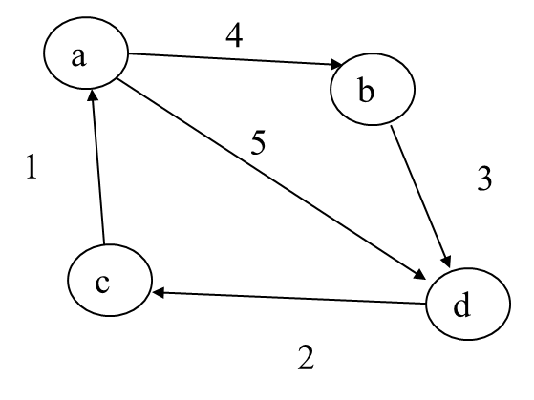
Adjacency Matrix : Example
 | a | b | c | d
a | 0 | 1 | 0 | 1
b | 0 | 0 | 0 | 1
c | 1 | 0 | 0 | 0
d | 0 | 0 | 1 | 0
 | a | b | c | d
a | 0 | 4 | 0 | 5
b | 0 | 0 | 0 | 3
c | 1 | 0 | 0 | 0
d | 0 | 0 | 2 | 0
Adjacency Matrix
Weighted Adjacency Matrix

Slide 8
Adjacency Matrix : Example
A
B
D
C
 | A | B | C | D
A | 0 | 1 | 1 | 1
B | 1 | 0 | 1 | 1
C | 1 | 1 | 0 | 1
D | 1 | 1 | 1 | 0

Slide 9
adjacency matrix
0
1
2
3
4
A B C D E
0
A
1
4
B
E
0 1 2 3 4
0
1
2
3
4
0 1 1 0 1
0 0 1 0 0
0 1 0 1 0
0 0 0 0 0
0 0 0 0 0
C
D
2
3

Slide 10
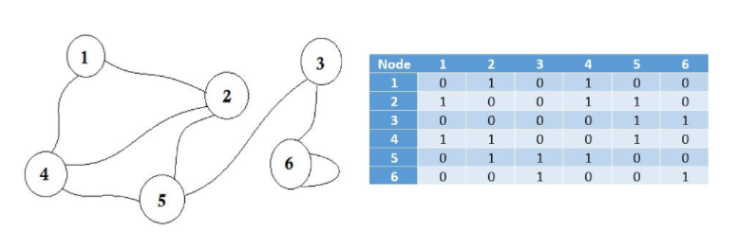
Example

Slide 11
Adjacency lists
0
0
1
2
3
4
A B C D E
A
1
4
B
E
C
D
0
1
2
3
4
1 2 4
2
3
2
1
3

Slide 12
0
1
2
3
1
2
3
0
0
2
3
0
1
3
1
2
0
1
2
3
G1
0
1
2
0
1
0
2
1
G2
2

Slide 13
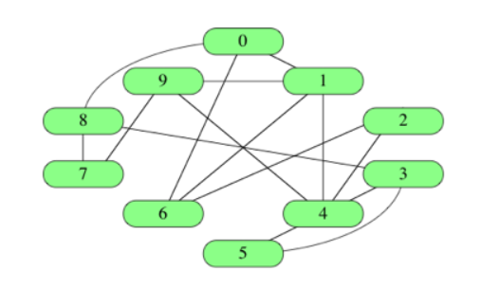
Graph

Slide 14
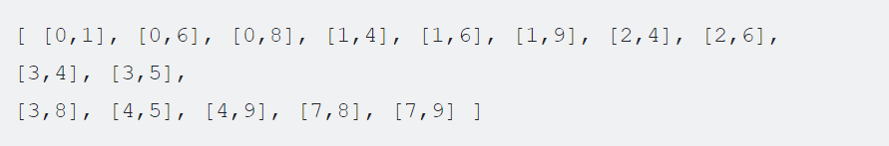
Edge list

Slide 15
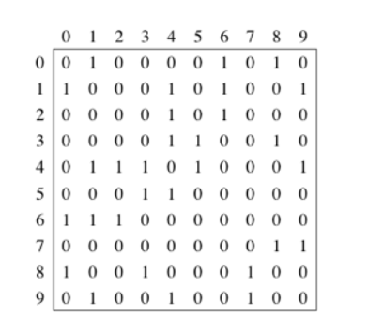
Adjacency matrix

Slide 16
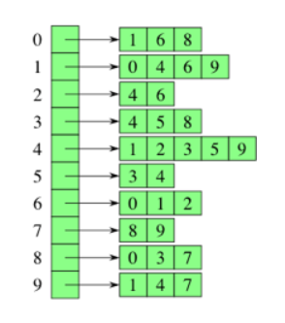
Adjacency list

Slide 17
Drawbacks of adjacency matrix
Memory is a huge problem. No matter how many edges are there, we will always need N * N sized matrix where N is the number of nodes. If there are 10000 nodes, the matrix size will be 4 * 10000 * 10000 around 381 megabytes. This is a huge waste of memory if we consider graphs that have a few edges.
Suppose we want to find out to which node we can go from a node u. We'll need to check the whole row of u, which costs a lot of time.
The only benefit is that, we can easily find the connection between u-v nodes, and their cost using Adjacency Matrix.

Slide 18
Time complexity
Adjacency matrix O(n^2)
Adjacency list O(m+n) where m is the total number of edges and n is the total number of nodes.

Slide 19
Graph Traversing
A traversal (search):
An algorithm for systematically exploring a graph
Visiting (all) vertices
Until finding a goal vertex or until no more vertices
Only for connected graphs
Given: a graph G = (V, E), directed or undirected
Goal: methodically explore every vertex and every edge

Slide 20
Graph Traversing Methods
Breadth-First Search (BFS)
Expand the shallowest unexpanded (unmarked) node.
Implementation: queue
Depth-First Search (DFS)
Expand the deepest unexpanded (unmarked) node.
Implementation: stack or recursion.

Slide 21
Breadth-First Search (BFS)
BFS is a graph traversal technique in which we traverse all the nodes in a breadth-wise motion.
Traverse one level at a time and then jump to the next level.
In a graph, the traversal can start from any node and cover all the nodes level-wise.
In BFS the queue data structure is used for implementation.
In BFS, we always reach the final goal state (which was not always the case for DFS).

Slide 22
The general BFS algorithm
Each vertex can be in one of three states:
Unmarked and not on queue
Marked and on queue
Marked and off queue
The algorithm moves vertices between these states
The purpose of the algorithm is to mark each vertex as visited while avoiding cycles.

Slide 23
Handling vertices
Unmarked and not on queue:
Not reached yet
Marked and on queue:
Known, but adjacent vertices not visited yet (possibly)
Marked and off queue:
Known, all adjacent vertices on queue or done with

Slide 24
Breadth-First Search
create a queue Q
mark v as visited and put v into Q
while Q is non-empty
remove the head u of Q
mark and enqueue all (unvisited) neighbors of u

Slide 25
Breadth-first search
The algorithm works as follows:
Start by putting any one of the graph's vertices distance d = 0 at the back of a queue.
Take the front item of the queue and add it to the visited list.
Create a list of that vertex's (at distance d) adjacent nodes (at distance d+1). Add the ones which aren't in the visited list to the back of the queue.
Keep repeating steps 2 and 3 until until no new vertex is discovered and the queue become empty.

Slide 26
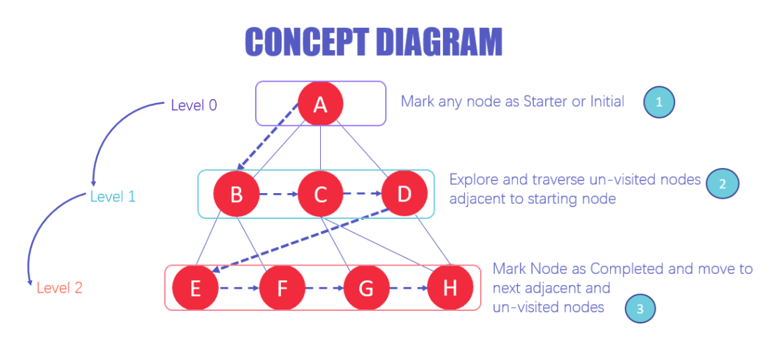

Slide 27
BFS in a binary tree (reminder)
BFS: visit all siblings before their descendents
5
2
8
1
3
6
10
7
9
5 2 8 1 3 6 10 7 9

Slide 28
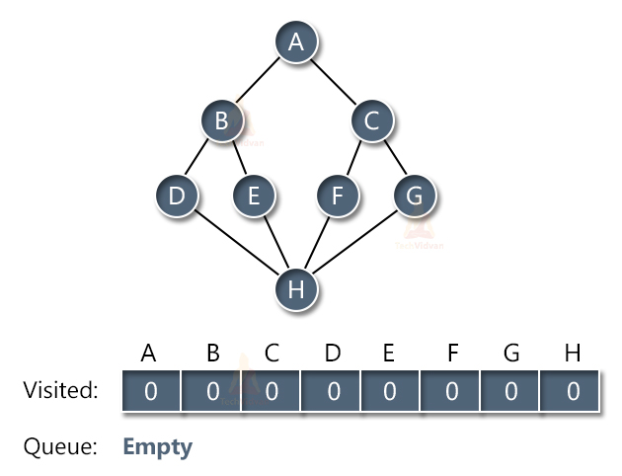
BFS
Consider the following graph having 8 nodes named as A, B, C, D, E, F, G and H as shown:

Slide 29
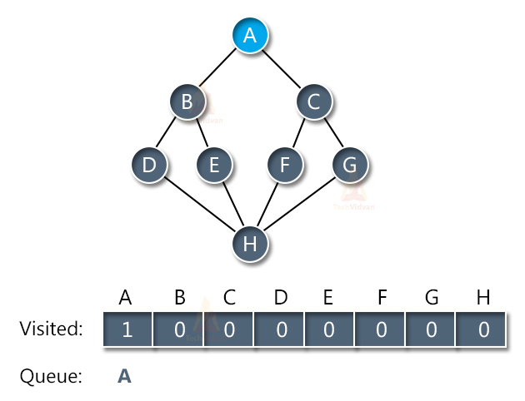
Initially, the queue will be empty. Let us start traversing the graph from node A. Once we visit node A, we mark it as visited and also place it inside the queue as shown:

Slide 30
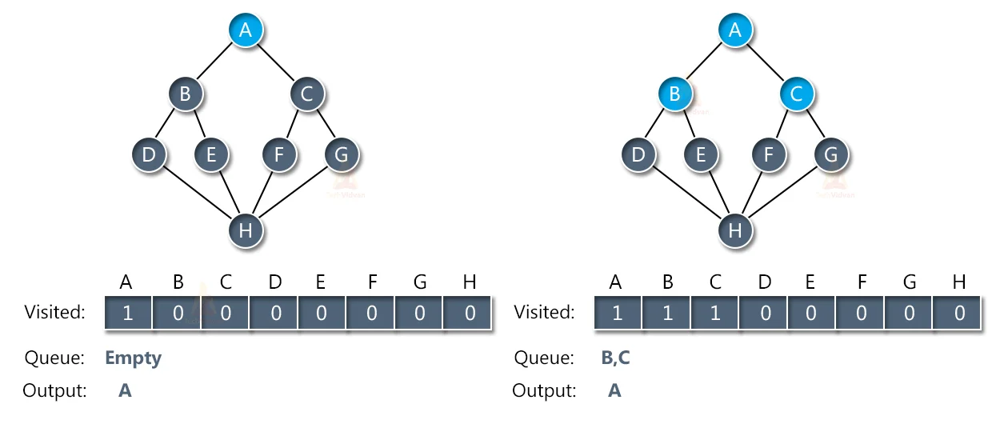
The next step is to traverse its adjacent nodes i.e. B and C and place them inside the queue. When we place the adjacent node of A in the queue, we will remove A from the queue and display it in the output array as shown:

Slide 31
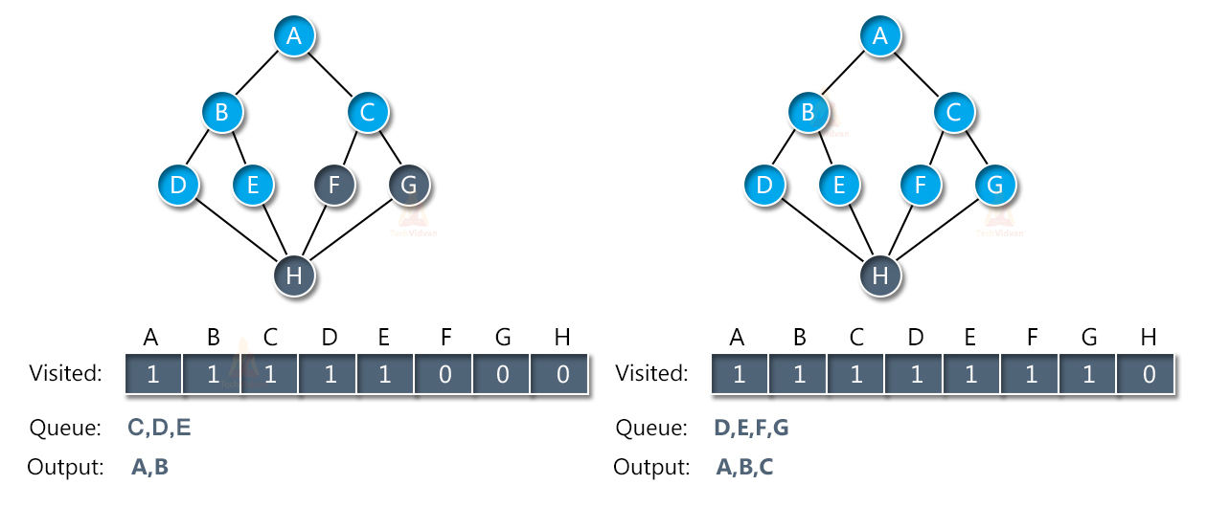
Next, we don’t have any more adjacent nodes for A. therefore, we will remove node B from the queue and place its adjacent nodes into the queue. Similarly, we will traverse the nodes of C and put them into the queue.

Slide 32
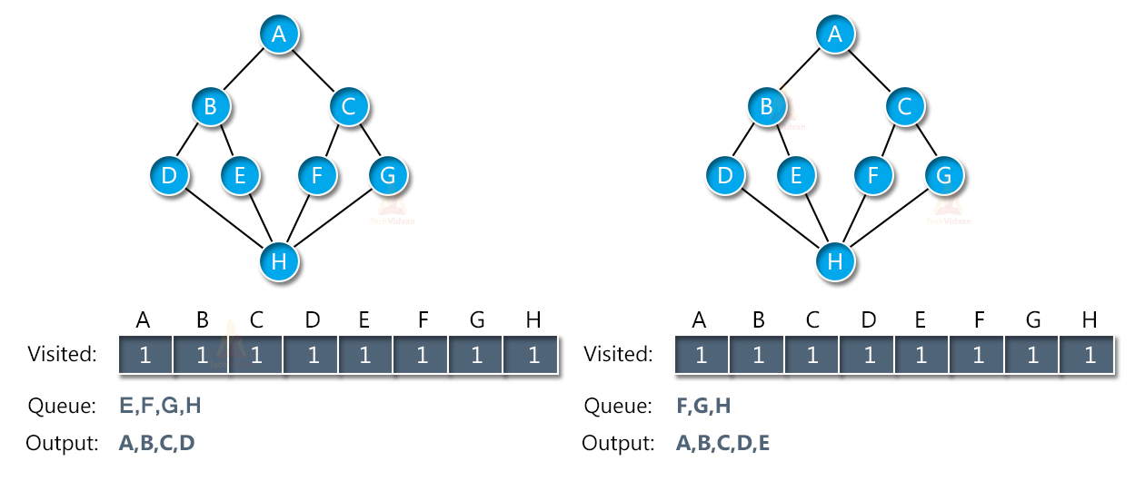
The next adjacent node is node H. thus, we will traverse that as well and place it in the queue. Once all the nodes have entered the queue, we will start removing them from the queue and putting them into the output array.

Slide 33
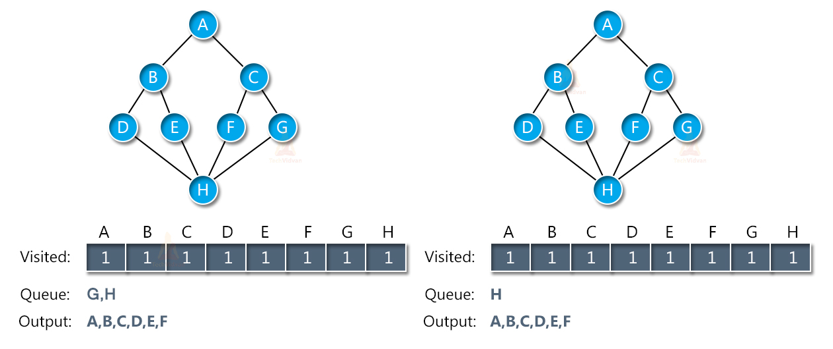
Thus, slowly the queue starts decreasing in size and the output array will be full as shown:

Slide 34
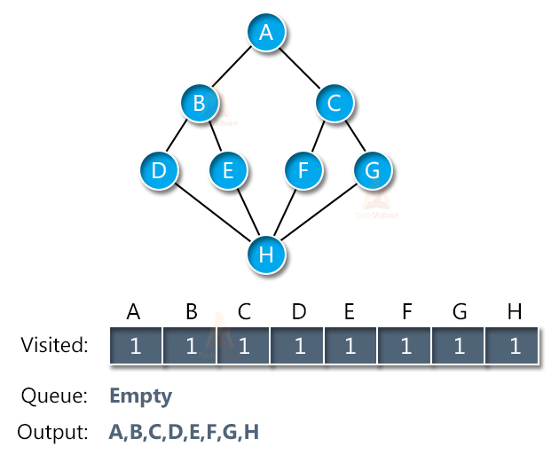
In this way, we will get the output of BFS to be A→B→C→D→E→F→G→H.
Notes:
https://techvidvan.com/tutorials/breadth-first-search/

Slide 35
Queue: A
A
B
E
G
C
D
F
Start with A. Put in the queue (marked red)

Slide 36
Queue: A B E
A
B
E
G
C
D
F
B and E are next

Slide 37
Queue: A B E G C D F
A
B
E
G
C
D
F
When we go to B, we put G and C in the queue
When we go to E, we put D and F in the queue

Slide 38
Queue: A
A
B
E
G
C
D
F
Start with A. Mark it.

Slide 39
Queue: A B E
A
B
E
G
C
D
F
Expand A’s adjacent vertices.
Mark them and put them in queue.

Slide 40
Queue: A B E G C
A
B
E
G
C
D
F
Now take B off queue, and queue its neighbors.

Slide 41
Queue: A B E G C D F
A
B
E
G
C
D
F
Do same with E.

Slide 42
Queue: A B E G C D F
A
B
E
G
C
D
F
Visit C.
Its neighbor F is already marked, so not queued.

Slide 43
Queue: A B E G C D F
A
B
E
G
C
D
F
Visit G.

Slide 44
Queue: A B E G C D F
A
B
E
G
C
D
F
Visit D. F, E marked so not queued.

Slide 45
Queue: A B E G C D F
A
B
E
G
C
D
F
Visit F.
E, D, C marked, so not queued again.

Slide 46
Queue: A B E G C D F
A
B
E
G
C
D
F
Done. We have explored the graph in order:
A B E G C D F.

Slide 47
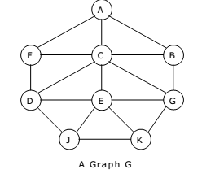
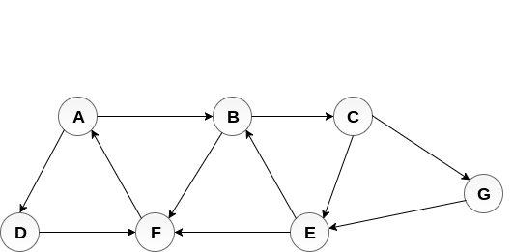

Slide 48
Applications of BFS
Un-weighted Graphs: BFS algorithm can easily create the shortest path and a minimum spanning tree to visit all the vertices of the graph in the shortest time possible with high accuracy.
P2P Networks: BFS can be implemented to locate all the nearest or neighboring nodes in a peer to peer network. This will find the required data faster.
Web Crawlers: Search engines or web crawlers can easily build multiple levels of indexes by employing BFS. BFS implementation starts from the source, which is the web page, and then it visits all the links from that source.
Navigation Systems: BFS can help find all the neighboring locations from the main or source location.
Network Broadcasting: A broadcasted packet is guided by the BFS algorithm to find and reach all the nodes it has the address for.

